Slide 1
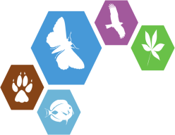

Pensoft Writing Tool
(PWT)
Lyubomir Penev
ViBRANT Tools for DNA taxonomists, 11 June 2013, Brussles
ViBRANT

Slide 2
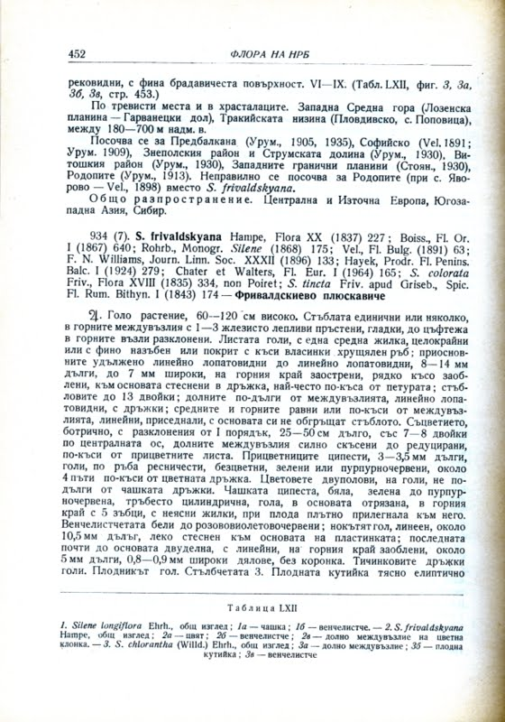
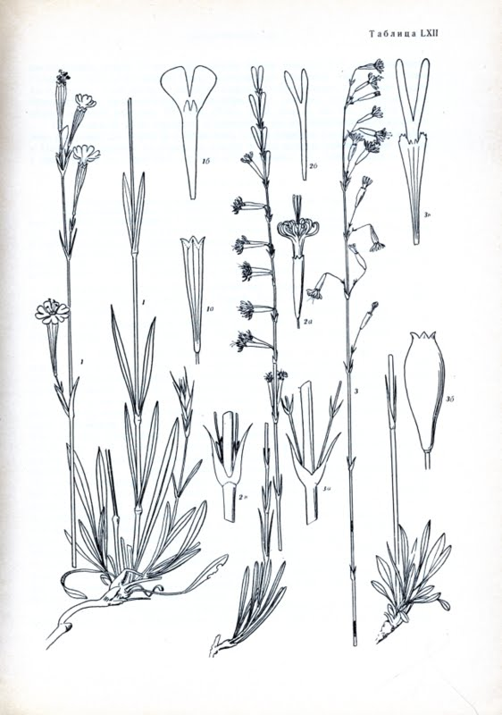
… and some hundreds millions pages of biodiversity literature in various languages

Slide 3
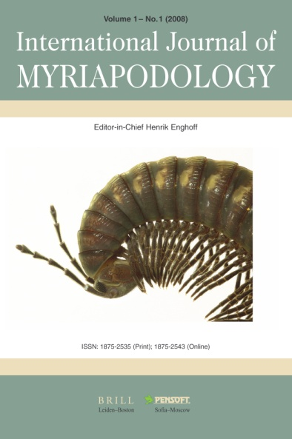
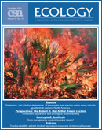

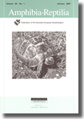
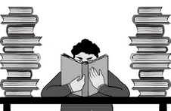
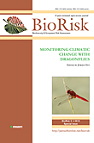
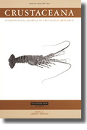
Estimated ca 1.8 Mio articles per annum, not counting the grey literature!

Slide 4
A solution?

Slide 5
Upfront mark up!

Slide 6
WHAT IS PWT
(Pensoft Writing Tool)?
http://pwt.pensoft.net

Slide 7
PWT is:
A collaborative article authoring and publishing platform for biodiversity science

Slide 8
PWT is:
The missing link!
For firs time ever, authoring, peer-review, editorial process, publication and dissemination within a single online collaborative platform!

Slide 9

No author guidelines! The tool will guide you!
Authors and additional contributors ( mentors, linguistic and copy editors, etc.) work collaboratively on an online document (manuscript)
Automated import of data-structured manuscripts generated in various platforms ( Scratchpads, authors’ databases)
Track change and comments
Revision history and version comparison
Pre-defined but flexible article templates (research articles, data papers, taxonomic treatments, software descriptions, and others)
Biological Codes-compliant Templates for taxonomic/nomenclatural acts
Various modes of data publishing (supplementary files, multimedia, import of data tables, linking to external data repositories, data papers)
Markup of text and data, with no additional effort for the authors
Pre-submission validation of the manuscript
Automated journal submission

Slide 10
Pensoft Writing Tool (PWT)
Collaborative online editing
Rich text capabilities
Various templates for taxon treatments
Identification keys builder
Assembling plates from single figures
References import (CrossRef, PubMed Central, etc.)
Contribitors
Mentor, lingustic editor, copy editor, colleague
Taxon treatment
Species occurrence data import (Darwin Core compliant)
Smart citation for figures, tables, references & automated positioning
Template
based
Interactive key
manuscript creation
Checklist
Lead author
Data paper
Coauthors
Notes:
10
Slide 12: Next generation article publishing
Arguably our most ambitious developments in the context of scholarly communication concern the semi-automated construction of scholarly papers from databases. In many cases Scratchpads contain extensive data relating to the biology and description of particular species. These are highly suited to formal specialist publications, but doing so require the laborious assembly of these data into a manuscript. As part of the ViBRANT collaboration with Pensoft, and in particular their two journals specialising in the formal taxonomic descriptions of plants and animals, we have developed a 5-step workflow for users to selecting appropriate data from their Scratchpad, adding additional metadata describing this information so that it conforms with the norms of descriptive taxonomic publications, and then finally preview and submit this manuscript to the publisher. From here is goes through a standard peer review process. Review recommendations are then incorporated in to a revised version of the manuscript, which is then sent back to the publisher and simultaneously published on both the Scratchpad and in the publisher’s journal.
In addition to dramatically speeding up the construction of scientific papers, the user has the advantage that firstly the manuscript can be revised and updated and new information comes to light on the Scratchpad, while preserving the original version of the manuscript as part of the scholarly record. In addition the publish extracts relevant information from the submitted database which is them automatically submitted to the specialist data repositories.
So in sum then, these are the four ways in which ViBRANT is facilitation scholarly communication of biodiversity information. 1) Through low cost journal infrastructure; 2) by community web publishing; 3) by biodiversity observation data publishing; and 4) by next generation publishing services producing scholarly articles from databases.

Slide 11







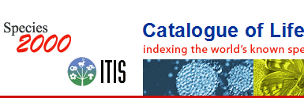

Workflow
Collaborative
ARTICLE AUTHORING
(PENSOFT WRITING
TOOL)
XML submission
Community peer-review
(options for public and
Open review)
ALL ONLINE!
Revisions
online
Authors, Reviewers, Editors, Mentors, Copyeditors
MANUSCRIPT published
XML text + data
ARTICLES
Biblio-
graphies
Occurr-
ence data
Taxon treatments
Taxon names
Plazi
Wiki
COL

Slide 12
Notes:
12
Slide 12: Next generation article publishing
Arguably our most ambitious developments in the context of scholarly communication concern the semi-automated construction of scholarly papers from databases. In many cases Scratchpads contain extensive data relating to the biology and description of particular species. These are highly suited to formal specialist publications, but doing so require the laborious assembly of these data into a manuscript. As part of the ViBRANT collaboration with Pensoft, and in particular their two journals specialising in the formal taxonomic descriptions of plants and animals, we have developed a 5-step workflow for users to selecting appropriate data from their Scratchpad, adding additional metadata describing this information so that it conforms with the norms of descriptive taxonomic publications, and then finally preview and submit this manuscript to the publisher. From here is goes through a standard peer review process. Review recommendations are then incorporated in to a revised version of the manuscript, which is then sent back to the publisher and simultaneously published on both the Scratchpad and in the publisher’s journal.
In addition to dramatically speeding up the construction of scientific papers, the user has the advantage that firstly the manuscript can be revised and updated and new information comes to light on the Scratchpad, while preserving the original version of the manuscript as part of the scholarly record. In addition the publish extracts relevant information from the submitted database which is them automatically submitted to the specialist data repositories.
So in sum then, these are the four ways in which ViBRANT is facilitation scholarly communication of biodiversity information. 1) Through low cost journal infrastructure; 2) by community web publishing; 3) by biodiversity observation data publishing; and 4) by next generation publishing services producing scholarly articles from databases.

Slide 13
Automated submission
Automated XML submission
Notes:
13
Slide 12: Next generation article publishing
Arguably our most ambitious developments in the context of scholarly communication concern the semi-automated construction of scholarly papers from databases. In many cases Scratchpads contain extensive data relating to the biology and description of particular species. These are highly suited to formal specialist publications, but doing so require the laborious assembly of these data into a manuscript. As part of the ViBRANT collaboration with Pensoft, and in particular their two journals specialising in the formal taxonomic descriptions of plants and animals, we have developed a 5-step workflow for users to selecting appropriate data from their Scratchpad, adding additional metadata describing this information so that it conforms with the norms of descriptive taxonomic publications, and then finally preview and submit this manuscript to the publisher. From here is goes through a standard peer review process. Review recommendations are then incorporated in to a revised version of the manuscript, which is then sent back to the publisher and simultaneously published on both the Scratchpad and in the publisher’s journal.
In addition to dramatically speeding up the construction of scientific papers, the user has the advantage that firstly the manuscript can be revised and updated and new information comes to light on the Scratchpad, while preserving the original version of the manuscript as part of the scholarly record. In addition the publish extracts relevant information from the submitted database which is them automatically submitted to the specialist data repositories.
So in sum then, these are the four ways in which ViBRANT is facilitation scholarly communication of biodiversity information. 1) Through low cost journal infrastructure; 2) by community web publishing; 3) by biodiversity observation data publishing; and 4) by next generation publishing services producing scholarly articles from databases.

Slide 14
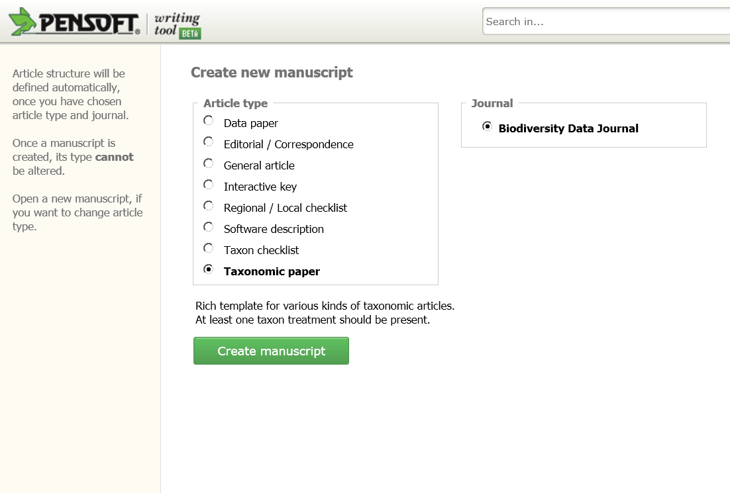
Article templates

Slide 15
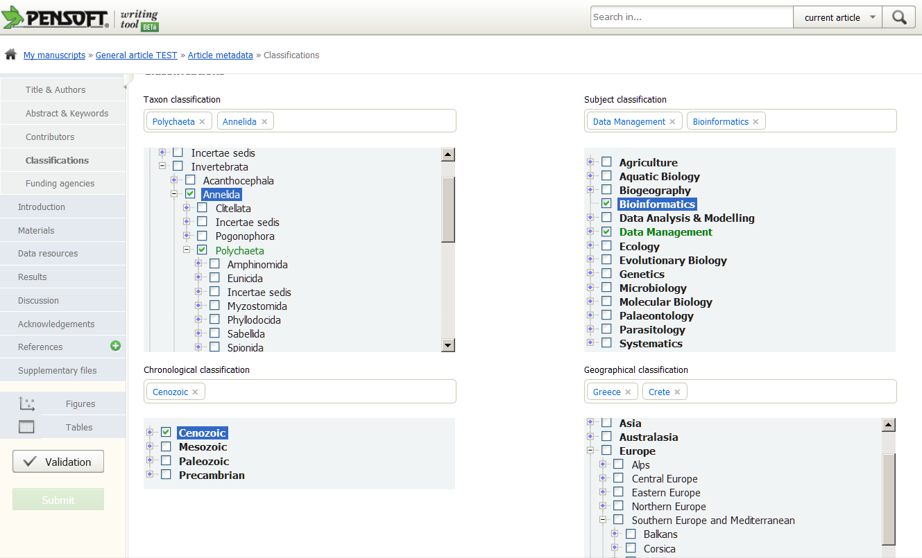
Classifications

Slide 16
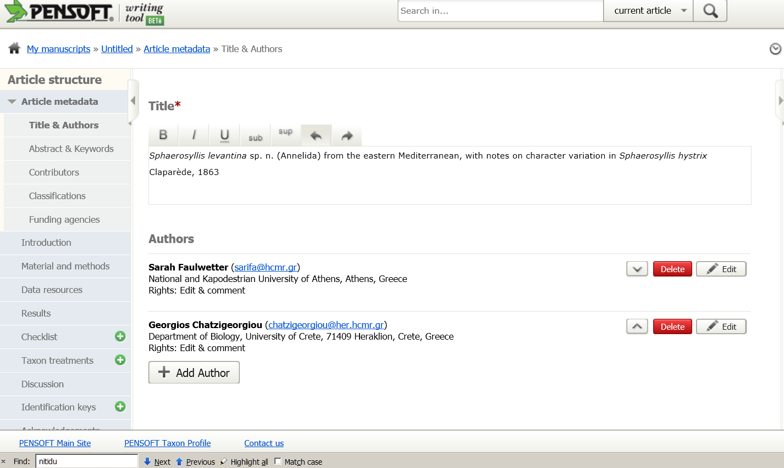

Slide 17
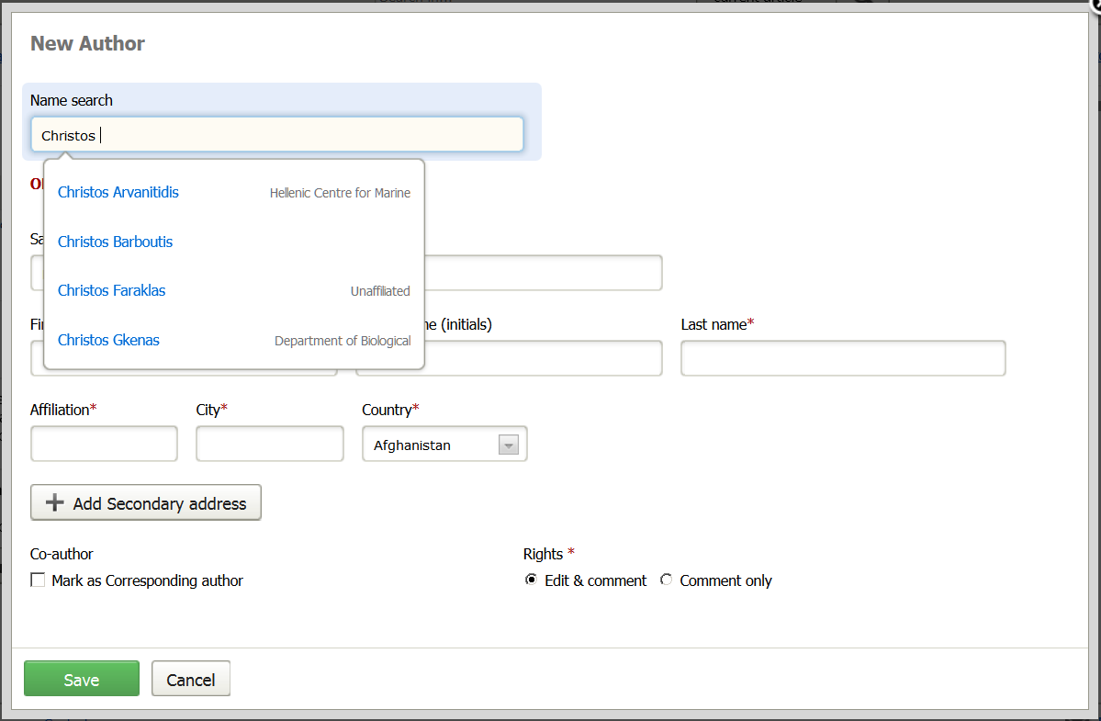
Add author

Slide 18
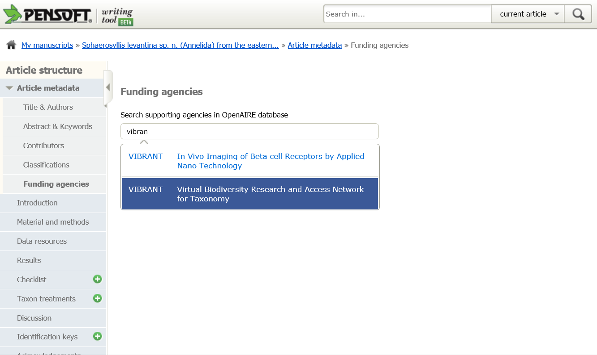

Slide 19
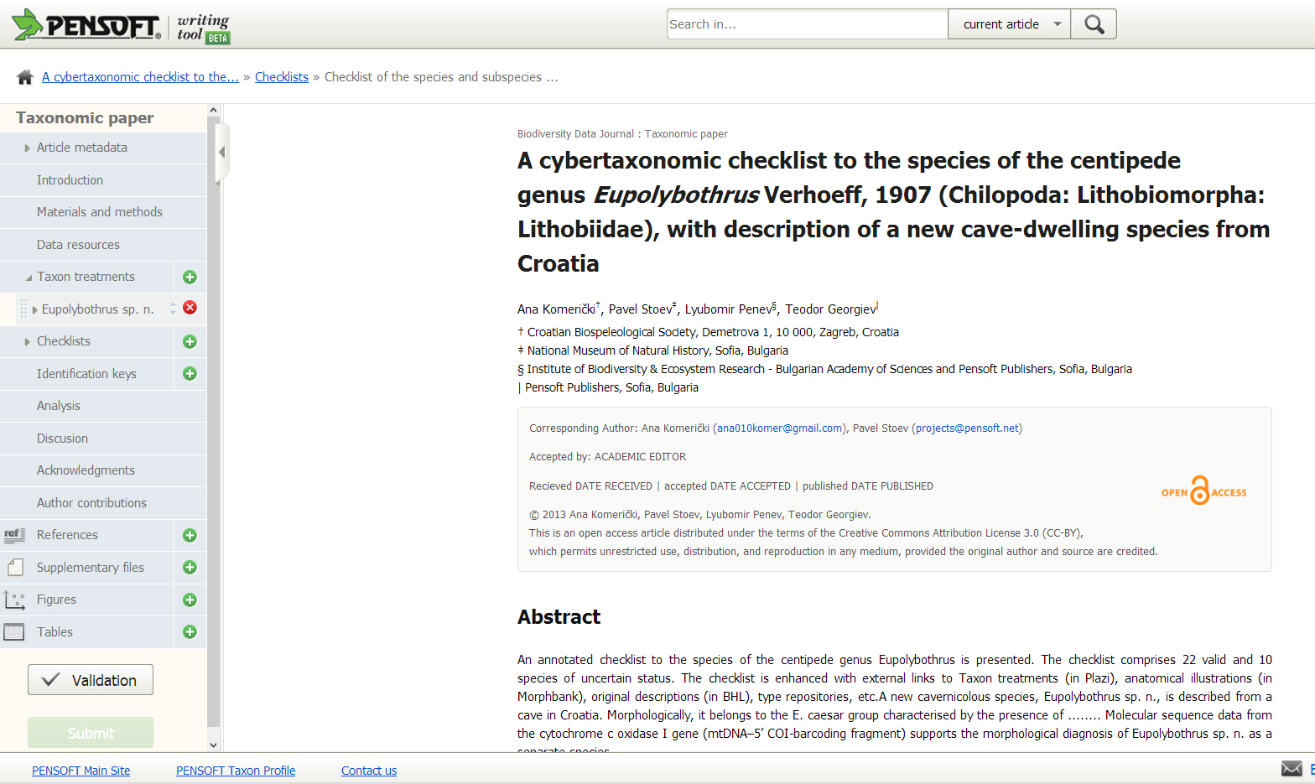
Cybertaxonomic checklist: structure

Slide 20
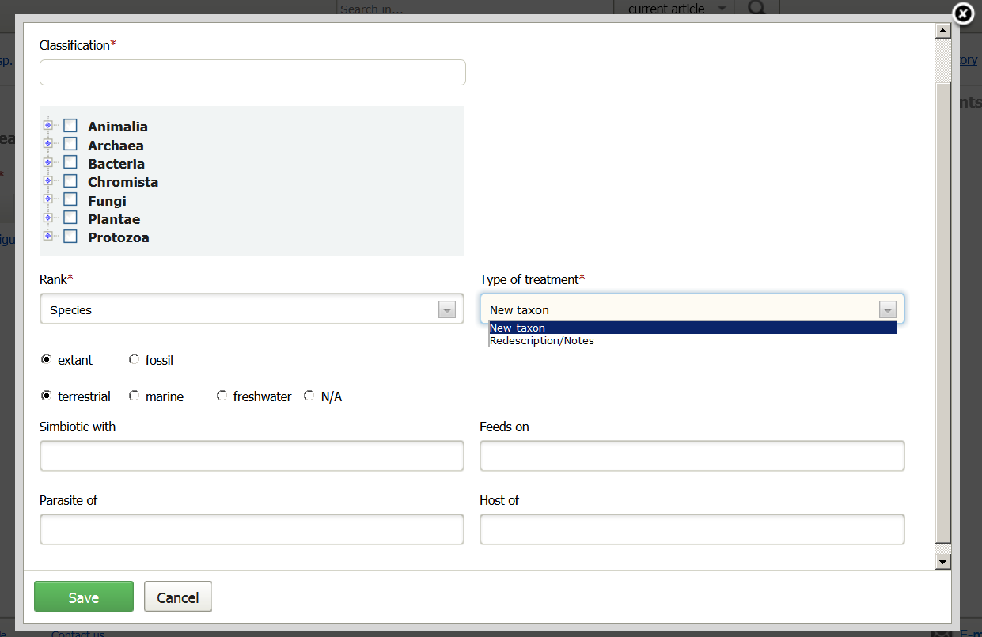

Slide 21
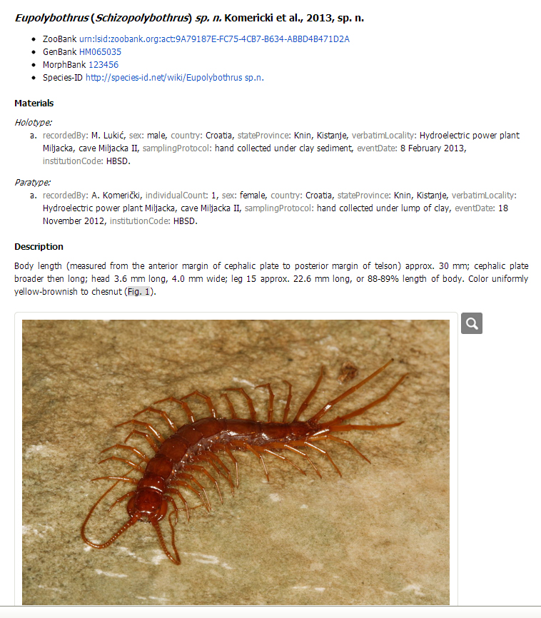
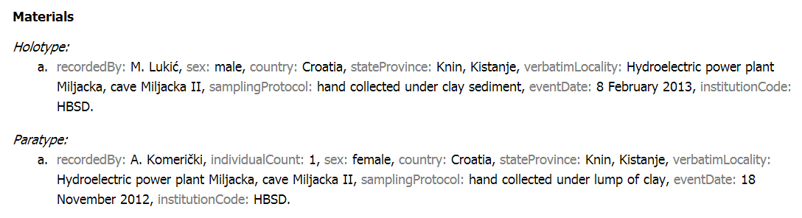
Taxon treatment: new species

Slide 22
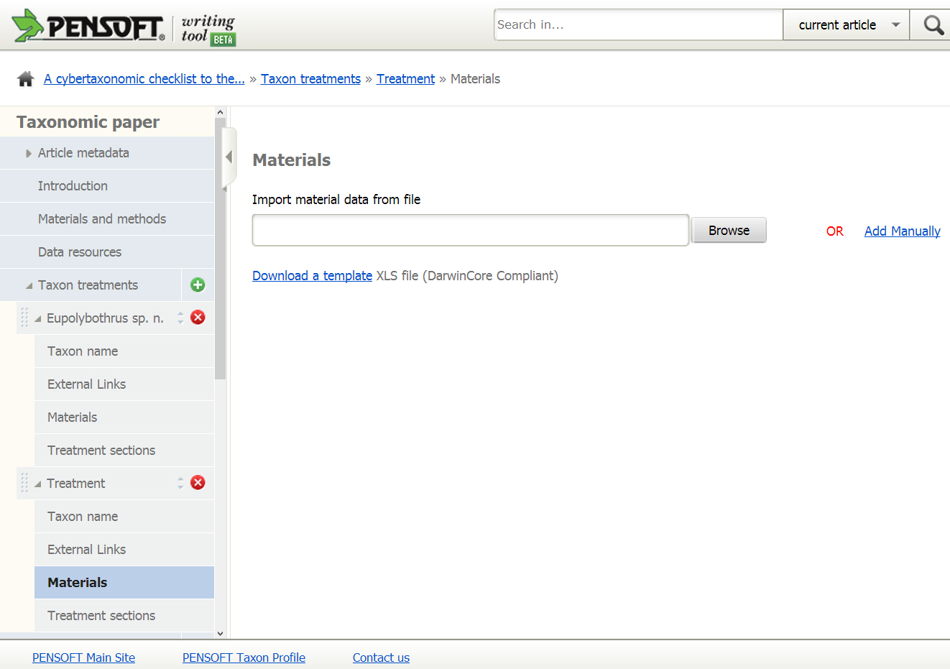
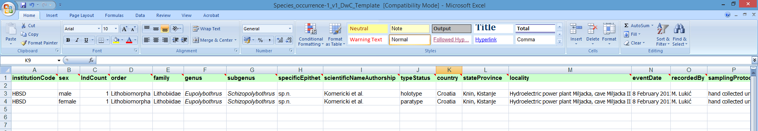
Taxon treatment: import material data

Slide 23
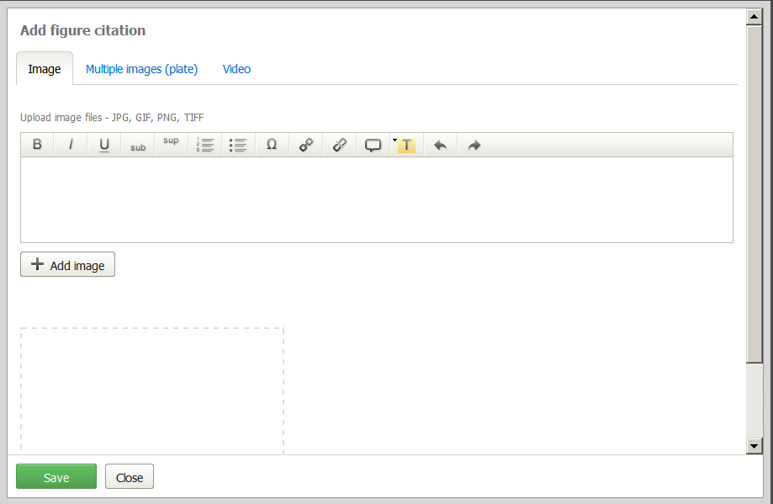
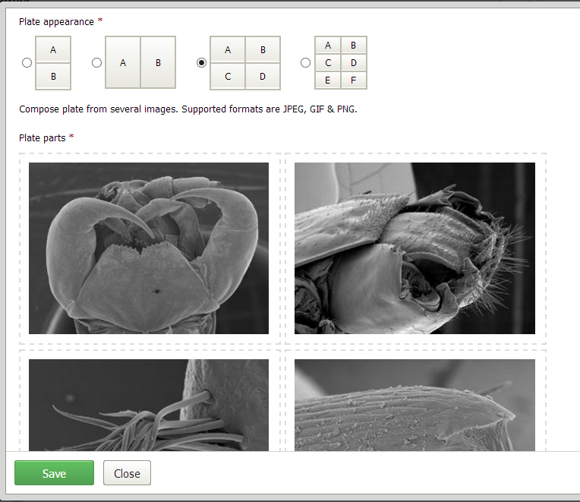
Taxon treatment: upload of images

Slide 24
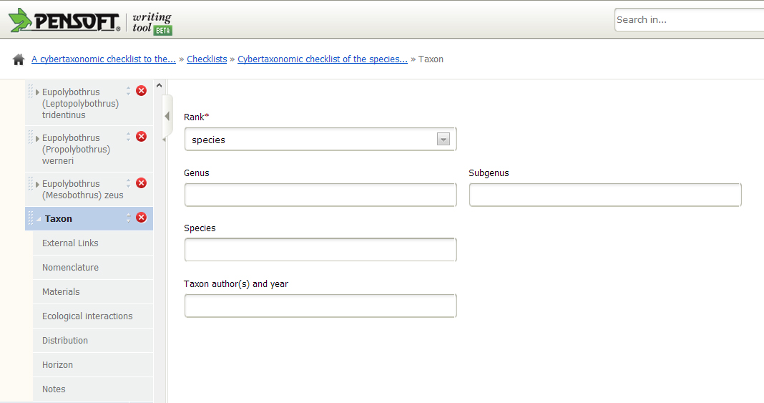
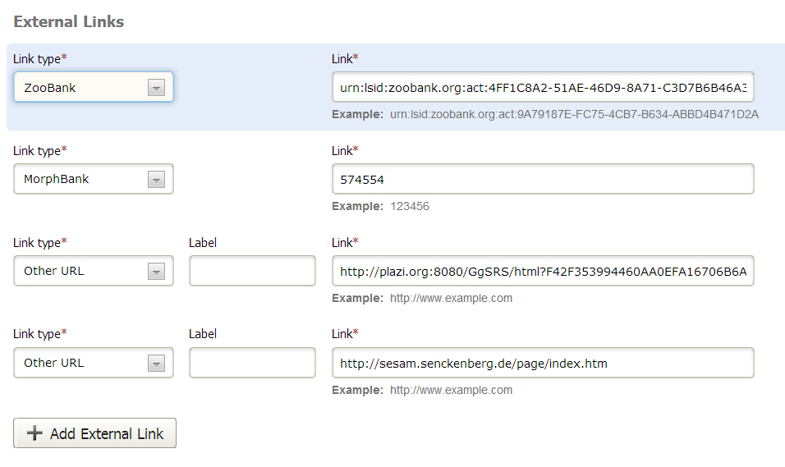
Structure of the checklist filed

Slide 25
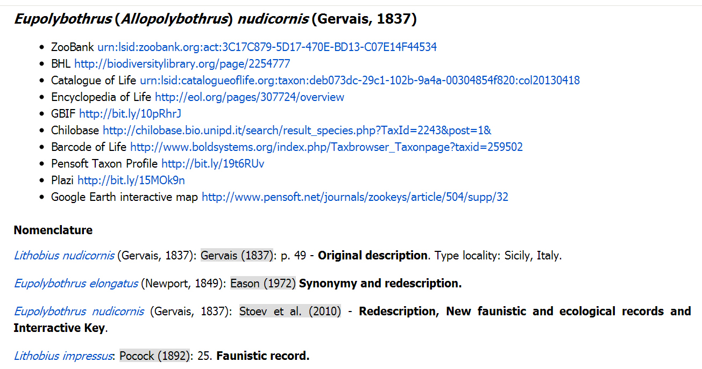
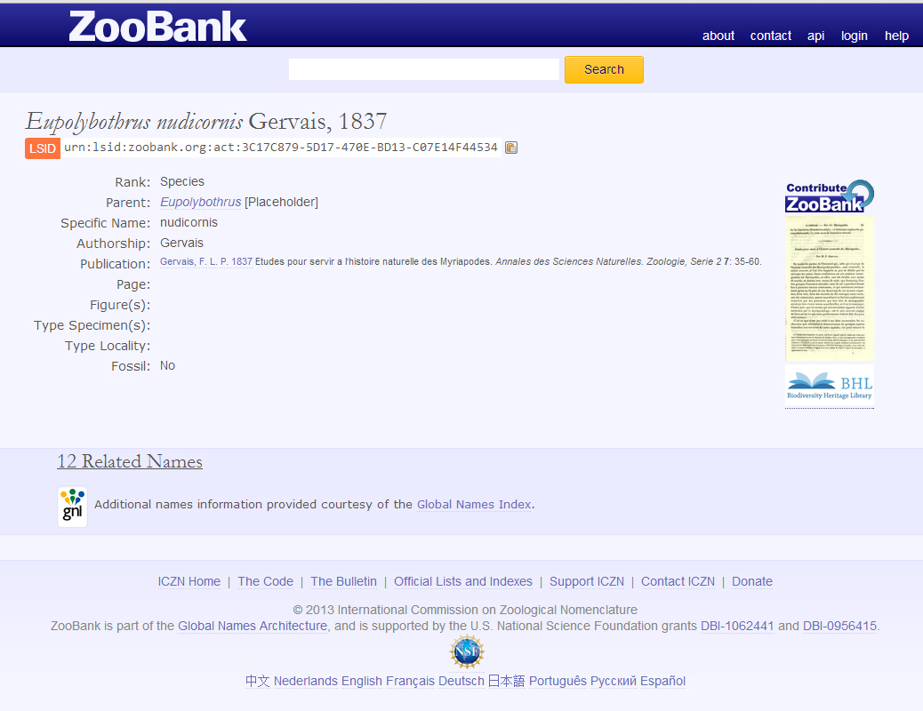
External links

Slide 26
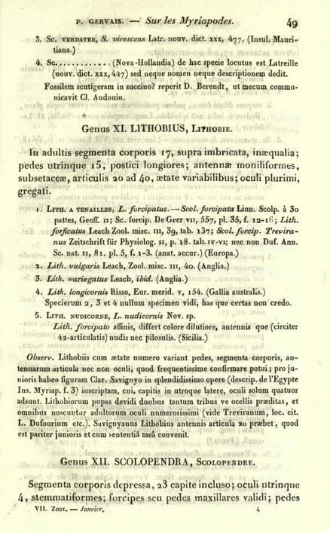
External links

Slide 27
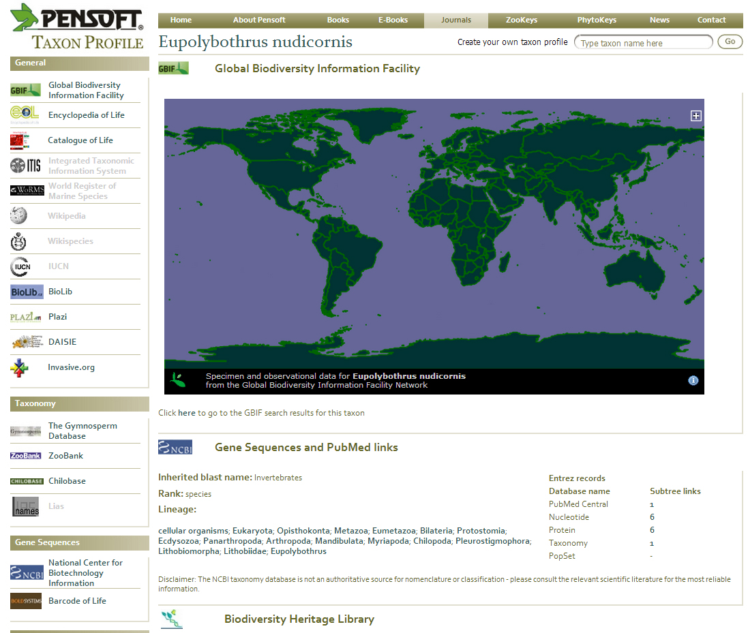
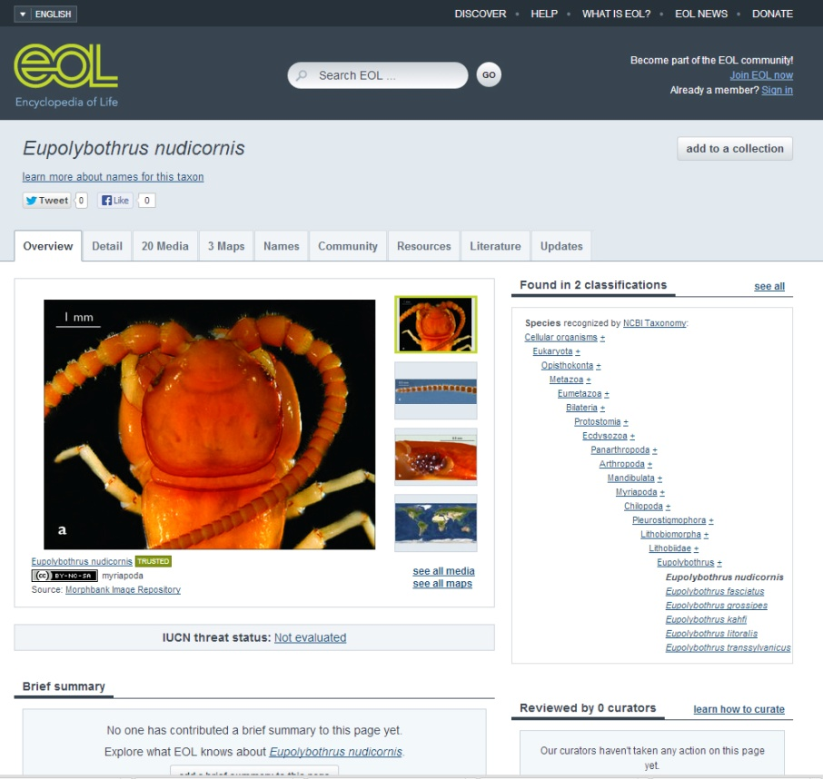
External links

Slide 28
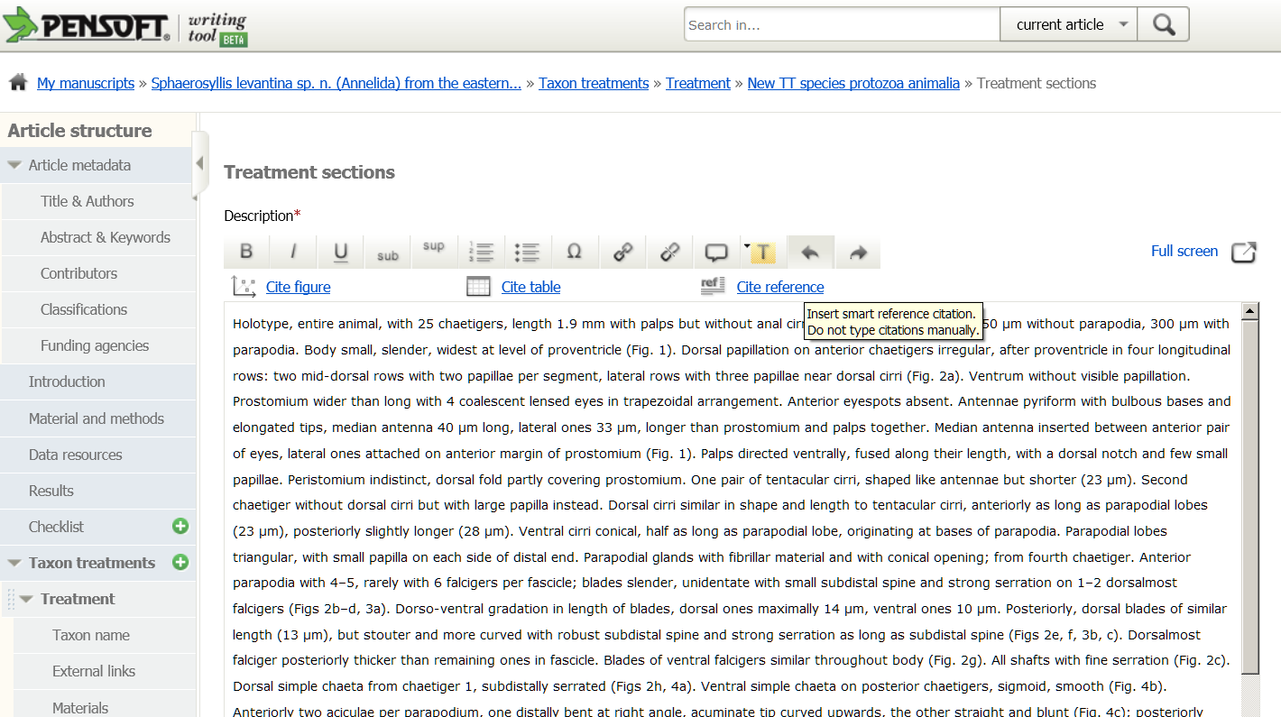

Slide 29
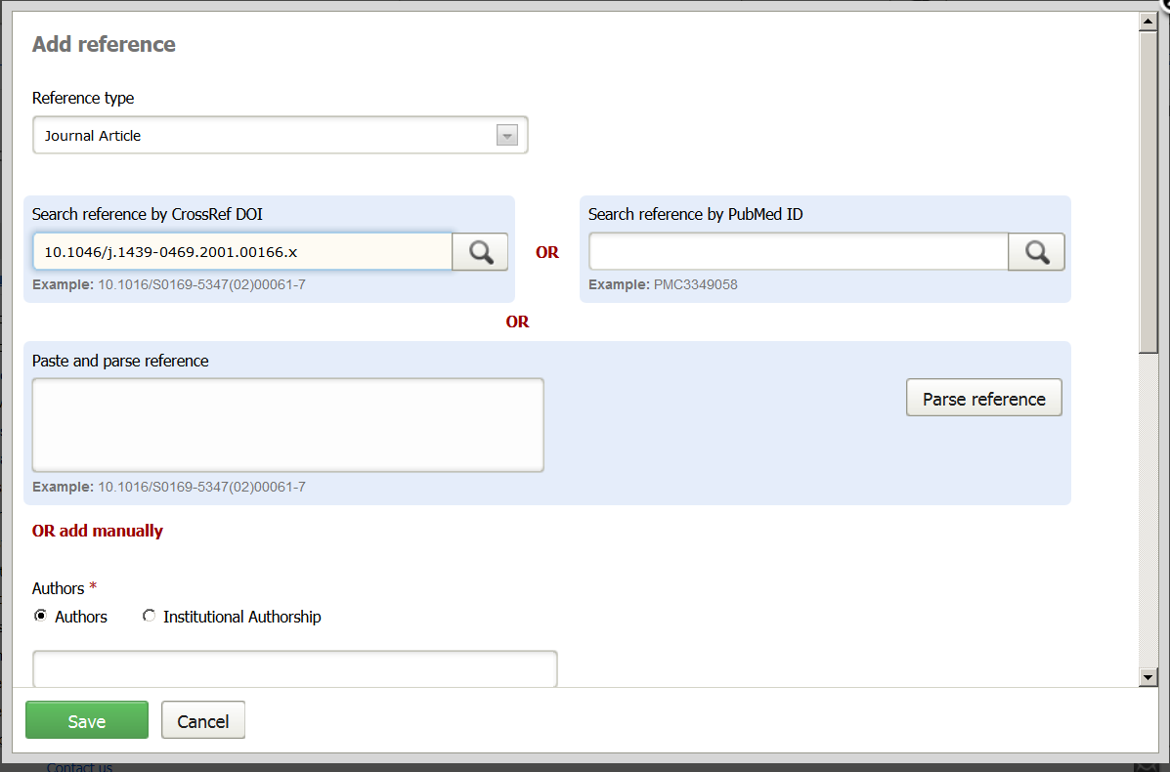

Slide 30
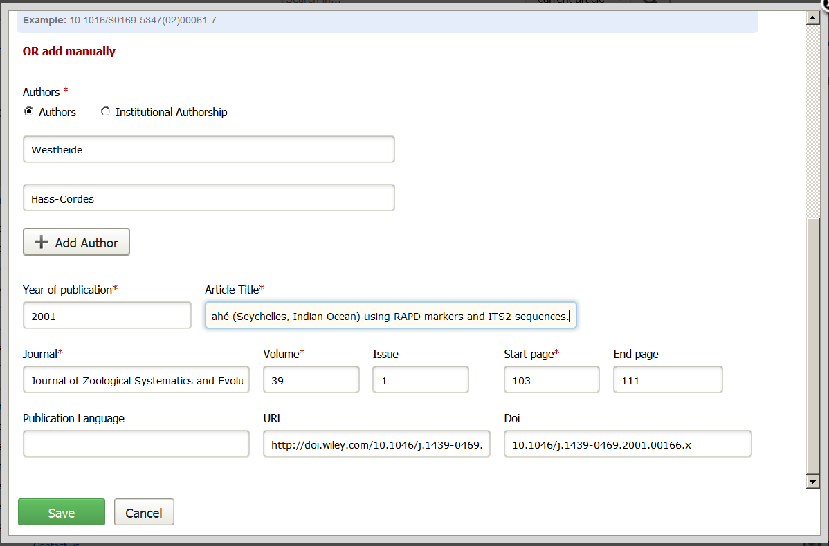

Slide 31
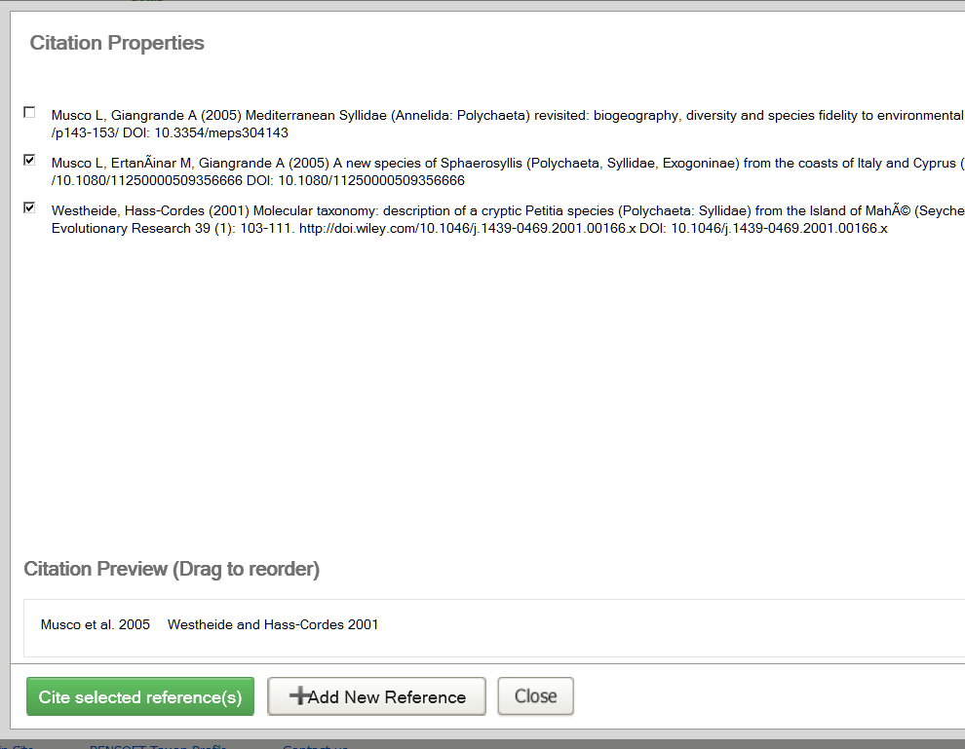

Slide 32
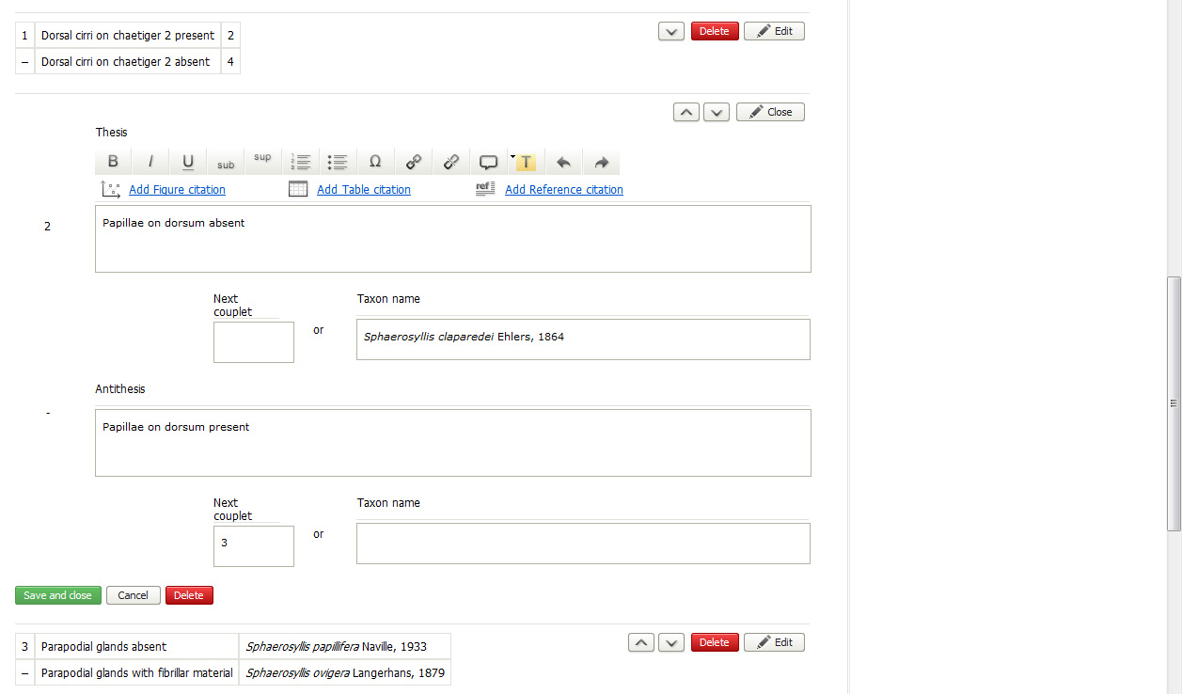
Construction
of key

Slide 33
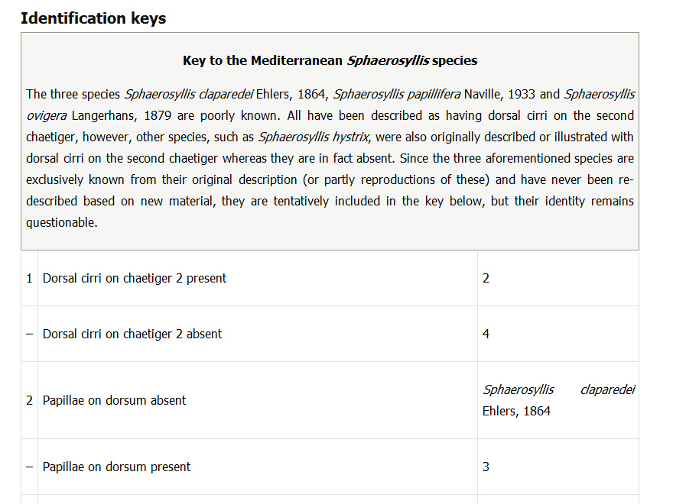
Key preview

Slide 34
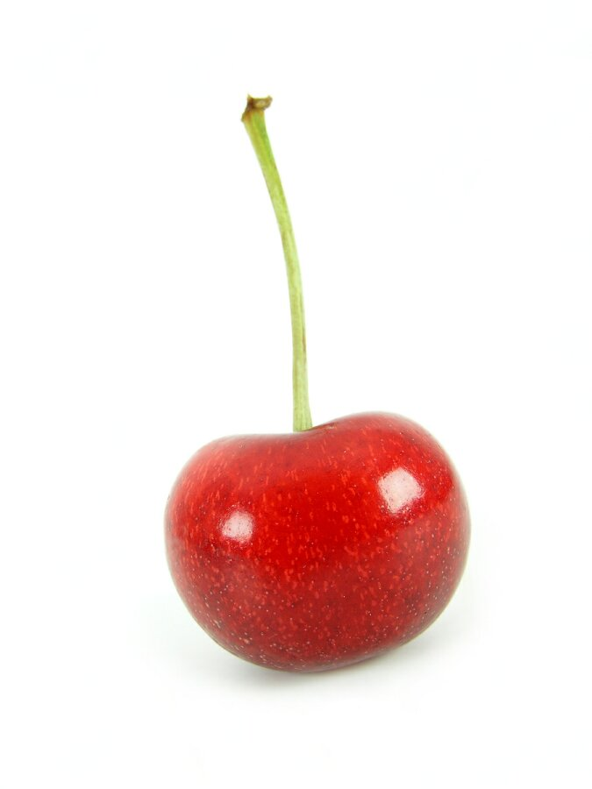

Slide 35
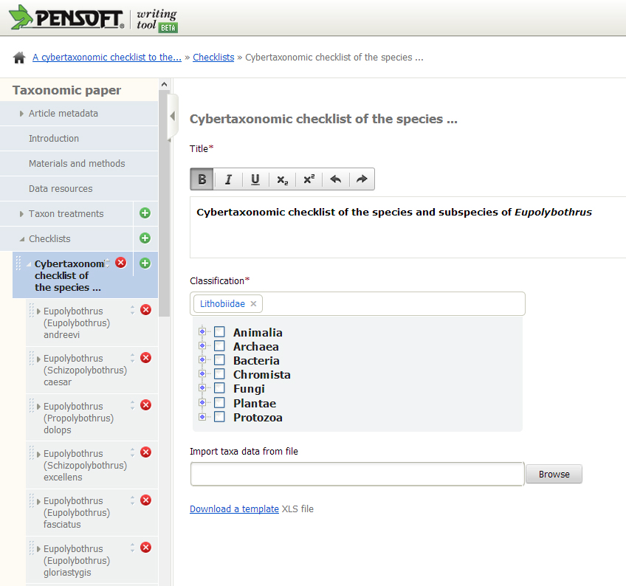
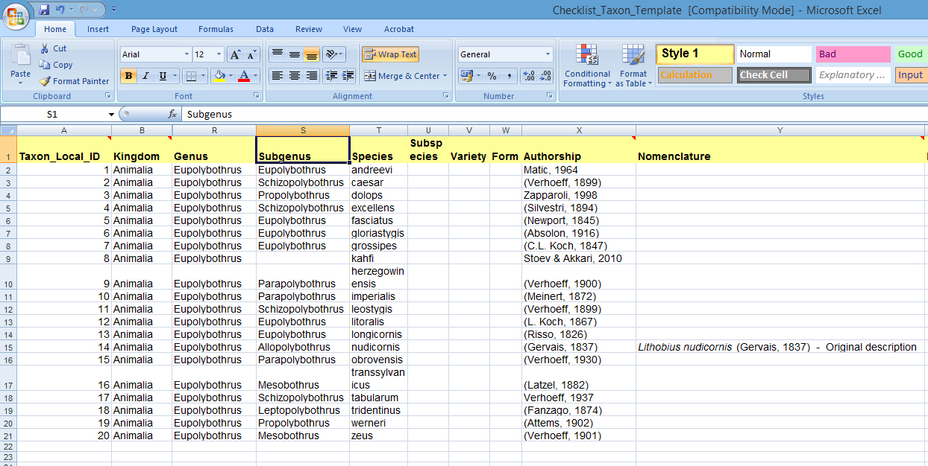
Import of checklists through Darwin Core template

Slide 36
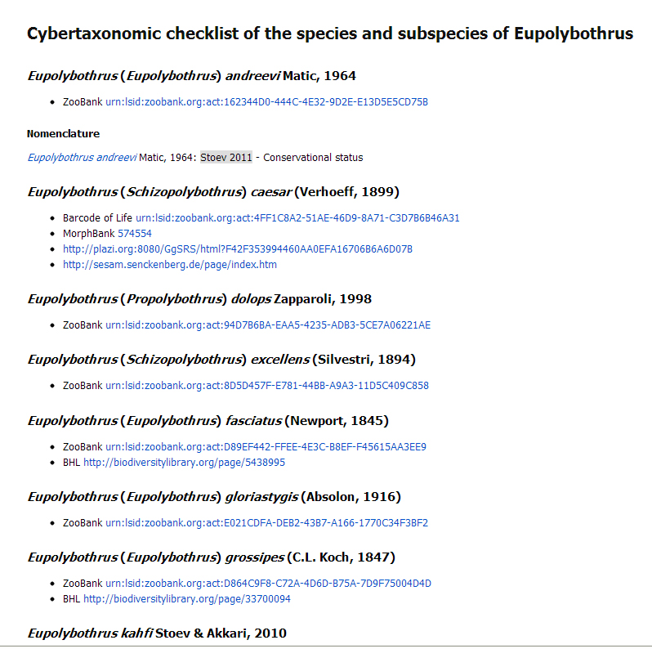

Slide 37
Time for commercials!

Slide 38
10-15 good reasons to use PWT

Slide 39
1.
Publishing of single taxon treatments and nomenclatural acts
NO need to wait to complete a revision

Slide 40
2.
Assembling treatments into regional Floras/Fauns

Slide 41
3.
Online collaboration at all stages between authors, editors, publisher

Slide 42
4.
Track change and comments
Revision history and version comparison

Slide 43
5.
NO Author Guidelines!
The tool will guide you!

Slide 44
6.
Manuscripts are formatted during writing
Avoid layout stage, decrease costs and efforts!

Slide 45
7.
Biological Codes and DawrinCore compliant

Slide 46
8.
Automated import of treatments from Scratchpads, EDIT, author databases

Slide 47
9.
Various modes of publishing data and multimedia

Slide 48
9.
Automated submission to journals
Published record, citation, dissemination

Slide 49
10.
Marked up text and data re-used for new projects

Slide 50
11.
Browser-independent

Slide 51
12.
No installation!
Just register and go!

Slide 52
PWT is free to use!

Slide 53
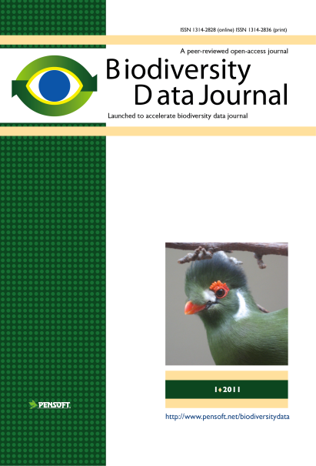
Why publish in the BDJ?
Joining (small) data into a large data pool
Open-access, archiving and re-using your data
Citation record for data through peer-reviewed publications
Easy online authoring/editorial process for authors, reviewers and editors
Innovative dissemination of atomized content
Very low-cost! Free in the launch phase, thereafter at fee that anyone can afford!
Coming in two months!
Editor Application Form http://www.pensoft.net/journals/bdj/editor_form.html
Notes:
53
Slide 12: Next generation article publishing
Arguably our most ambitious developments in the context of scholarly communication concern the semi-automated construction of scholarly papers from databases. In many cases Scratchpads contain extensive data relating to the biology and description of particular species. These are highly suited to formal specialist publications, but doing so require the laborious assembly of these data into a manuscript. As part of the ViBRANT collaboration with Pensoft, and in particular their two journals specialising in the formal taxonomic descriptions of plants and animals, we have developed a 5-step workflow for users to selecting appropriate data from their Scratchpad, adding additional metadata describing this information so that it conforms with the norms of descriptive taxonomic publications, and then finally preview and submit this manuscript to the publisher. From here is goes through a standard peer review process. Review recommendations are then incorporated in to a revised version of the manuscript, which is then sent back to the publisher and simultaneously published on both the Scratchpad and in the publisher’s journal.
In addition to dramatically speeding up the construction of scientific papers, the user has the advantage that firstly the manuscript can be revised and updated and new information comes to light on the Scratchpad, while preserving the original version of the manuscript as part of the scholarly record. In addition the publish extracts relevant information from the submitted database which is them automatically submitted to the specialist data repositories.
So in sum then, these are the four ways in which ViBRANT is facilitation scholarly communication of biodiversity information. 1) Through low cost journal infrastructure; 2) by community web publishing; 3) by biodiversity observation data publishing; and 4) by next generation publishing services producing scholarly articles from databases.

Slide 54
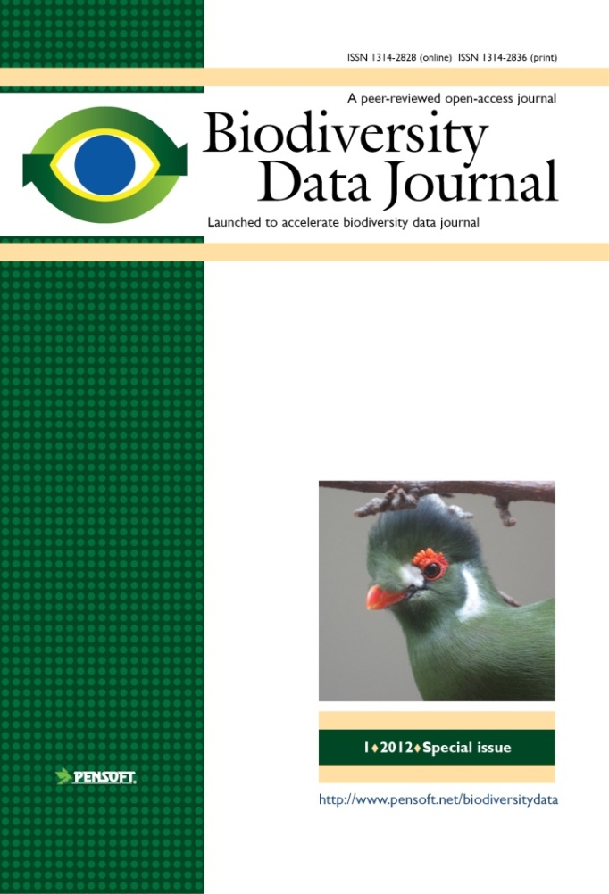

Thank you for your attention!
www.pensoft.net/journals/bdj
ViBRANT

